Slide 1
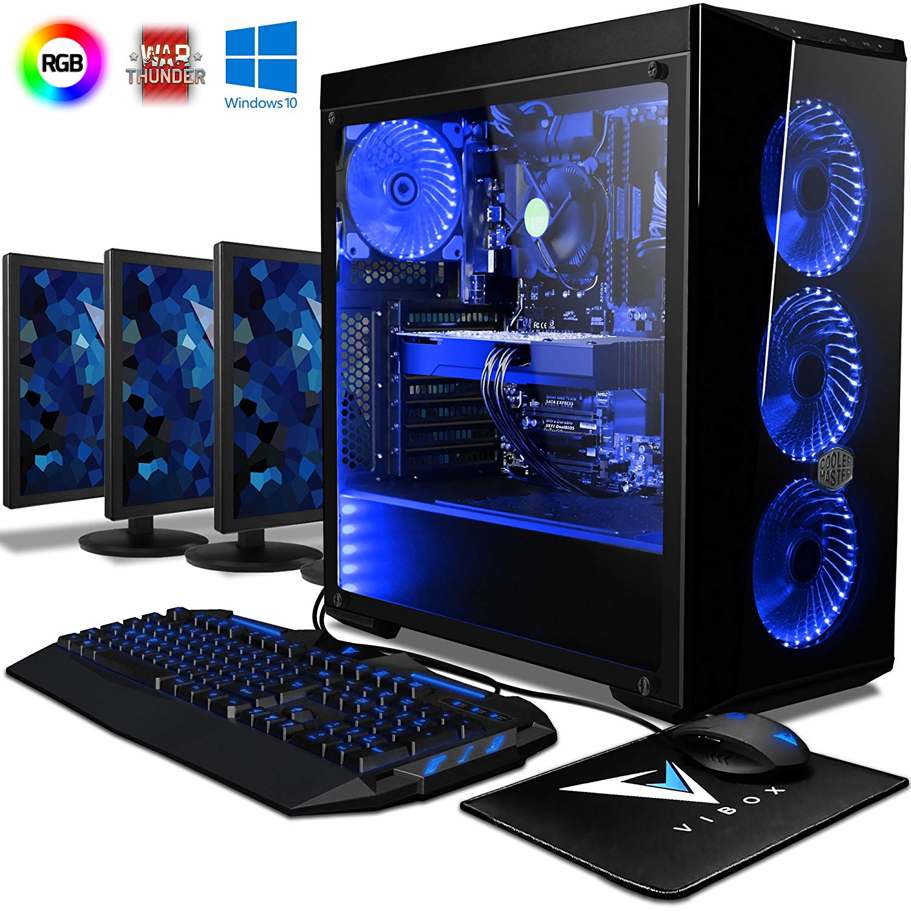
Gaming Computer
By: Zavere Vidal

Slide 2
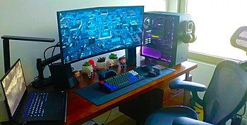
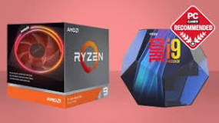
Game computer
A gaming computer is a desktop and a personal computer designed for playing video games that normally require a lot of computing power. It is often custom built for the purpose of increasing performance in modern computer games may require an increase graphical and processing power. One of the most known differences between regular and gaming machines is video processing.
A modern gaming computer is comparable to a mainstream computer with the addition of performance-oriented components, such as video cards and high core-count CPUs

Slide 3
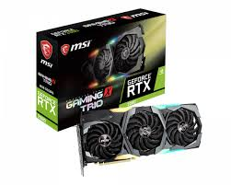
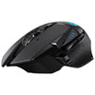
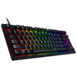
Would be nice features
A 4k graphics card like the MSI GeForce RTX 2080 Gaming X Trio. MSRP: $849.99. I wouldn’t personally buy a 4k graphics card because gaming computers already have a graphics card capable of keeping up with the graphics of the game even though the 4k would have brought out evenmore of the quality of the game
A upgraded colour coded gaming keyboard and mouse like the Razer Huntsman Tournament Edition Backlit Mechanical Linear Optical Switch Gaming Keyboard for $175.98 and the Logitech G502 LIGHTSPEED 16000 DPI Wireless Optical Gaming Mouse for $199.99 i wouldn't recommend buying an expensive keyboard and mouse, when you could basically play with a normal keypad and mouse or just look for a reasonably priced one

Slide 4
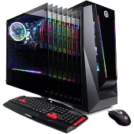
Budget Machine
I would buy the CyberPowerPC Gaming PC. The cost $729.99. And you can buy it from best buy online. With the leftover money i would upgrade the sound card and motherboard. The sound card i would suggest is the AVerMedia GC551 - Live Gamer Extreme 2 - Game Streaming and Video Capture - 4K Pass-Through - with Full HD 1080p 60fps. the sound card will cost $214.99 at canada computer and electronics. It is an reasonable price for a sound card this is good considering the audio capabilities. Finally i would upgrade the mb by buying th MSI Arsenal Gaming AMD Ryzen 2ND and 3rd Gen AM4 M.2 USB 3 DDR4 DVI HDMI Crossfire ATX Motherboard (B450 Tomahawk Max). The price is $159. And you can buy it online on amazon.

Slide 5
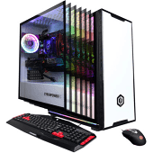
Dream Machine
My dream machine is the CyberPowerPC Gaming PC - White (AMD Ryzen 7 2700/2TB HDD/240GB SSD/16GB RAM/Radeon RX 580). You can buy in online at best buy for $1,099.99. It comes with all the main components that are updated like the AMD Ryzen 7 2700 processor with 16GB DDR4 RAM, AMD Radeon RX 580 graphics card with 4GB of video memory delivers ultra-smooth play and amazingly realistic visuals. So i don't have to spend more money buying parts, though it is expensive it is still a computer i would like to get someday because of the high compatible components in it giving smooth play, graphics and sound

